Slide 1
Exceptions Hierarchy in Java
we will learn the exception class hierarchy in java.lang package.
At the top of the exceptions hierarchy is the Throwable class. Every class that can be used for exception handling in Java directly or indirectly inherits from this class. The Throwable class is divided into two major subclasses:
Error
Exception.
Exceptions Hierarchy in Java
The figure below illustrates the class hierarchy of the Throwable class and its most significant subclasses

Slide 2
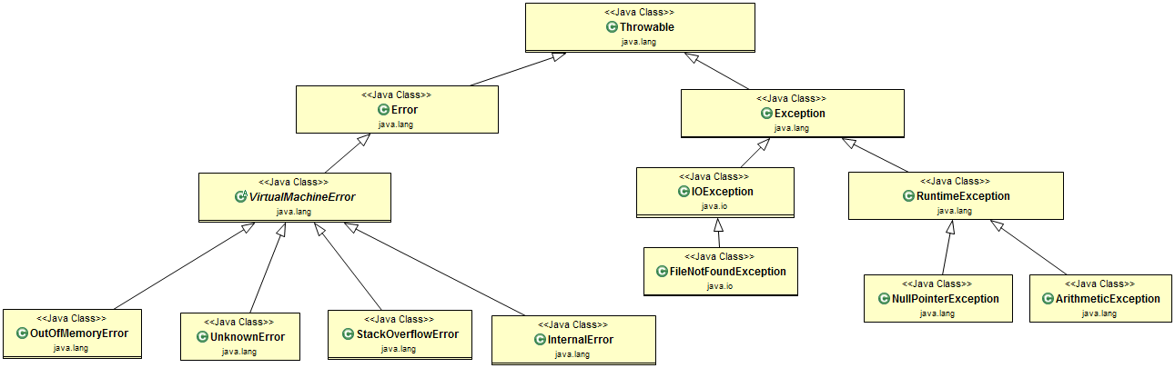

Slide 3
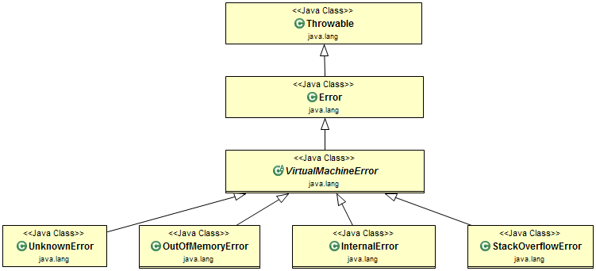
1. Error Class
The Error class and its subclasses represent abnormal conditions that should generally not be caught in your application. These indicate serious system problems, often JVM related, which an application might not be able to handle.
Hierarchy of Error Class
The figure below illustrates the class hierarchy of Error Class:

Slide 4
Learn more about below Java built-in errors:
OutOfMemoryError
StackOverflowError
NoClassDefFoundError
2. Exception
Checked Exceptions
These are exceptions that a method can throw but must either catch them or declare them using the throws keyword. They are direct subclasses of the Exception class, except RuntimeException.

Slide 5
2. Exception
Checked Exceptions
These are exceptions that a method can throw but must either catch them or declare them using the throws keyword. They are direct subclasses of the Exception class, except RuntimeException.
Java built-in checked exceptions:
FileNotFoundException
EOFException
ClassNotFoundException
SQLException
NoSuchMethodException
InterruptedException
The figure below illustrates the class hierarchy of the Exception Class:

Slide 6
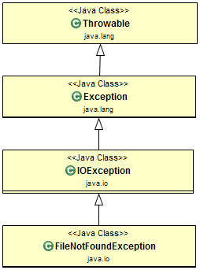
Exception Class Example: In this example, FileReader class try to read a file from an invalid location will throw FileNotFoundException exception.

Slide 7
public class FileNotFoundExceptionExample {
public static void main(String[] args)
{
BufferedReader reader = null;
try {
reader = new BufferedReader(new FileReader(new File("/invalid/file/location")));
}
catch (FileNotFoundException e)
{
System.err.println("FileNotFoundException caught!");
}
}
}

Slide 8
RuntimeException (Unchecked Exceptions)
These exceptions are not checked at compile-time. They're a direct subclass of the RuntimeException class.
Java built-in unchecked exceptions:
NullPointerException
ArrayIndexOutOfBoundsException
StringIndexOutOfBoundsException
ArithmeticException
IllegalArgumentException
NumberFormatException
IllegalStateException
ClassCastException

Slide 9
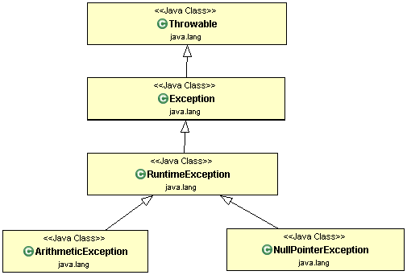

Slide 10
RuntimeException Example: In the below example, the Person class object is not created using the new keyword but it is just declared with a null value. Now we are trying to access the personName field value on the null reference so JVM will throw a NullPointerException exception here.
public class NullPointerExceptionExample {
public static void main(String[] args)
{
Person personObj = null;
try {
String name = personObj.personName; // Accessing the field of a null object personObj.personName = "Jon Doe"; // Modifying the field of a null object }

Slide 11
catch (NullPointerException e)
{
System.err.println("NullPointerException caught!");
}
}
}
class Person
{
public String personName;
public String getPersonName()
{
return personName; }
public void setPersonName(String personName)
{
this.personName = personName;
}
}

Slide 12
Output:
NullPointerException caught!

